Slide 1
LangBot 🌎
Kishan Brahmbhatt, David Gutierrez, Nayan Paul, Saloni Shivdasani, Liz Wigglesworth
Notes:
Presentation overview:
Intro to langbot (w/ gifs and photos) - 45 seconds
Demo (live demo with video/gifs as backup) - 2 min
Tech stack - 45 seconds
Roadblocks & how we overcame them- 45 seconds
Business value/competition - 45 seconds
Future of project- 30 seconds
Question time!

Slide 2
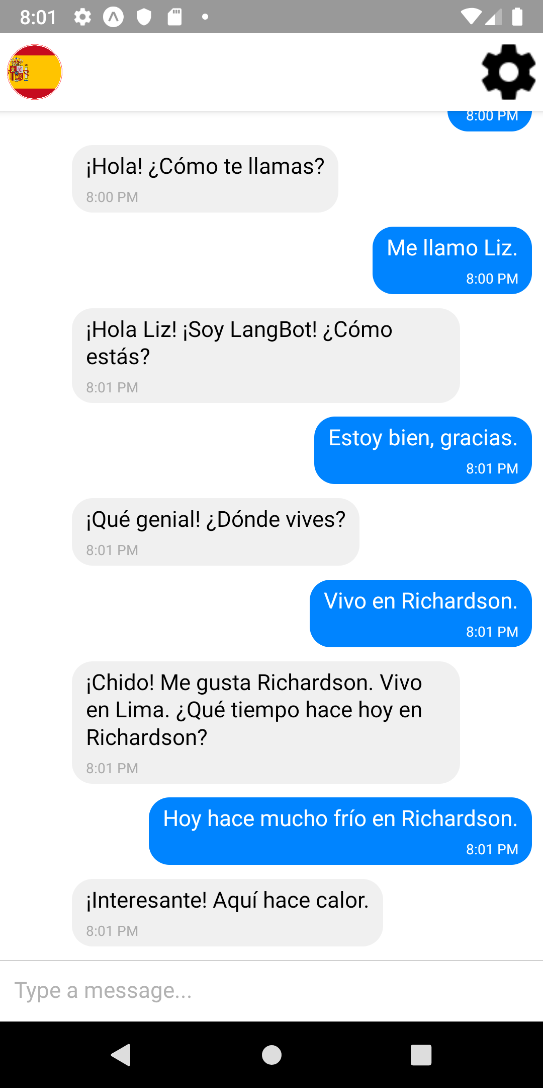
Learn through conversation
LangBot responds to your messages
Notes:
Highlight core features
Responds to your messages
Organic conversation flow, like you’re messaging a person
Natural progression & cohesive conversations, not a collection of random sentences from a textbook

Slide 3
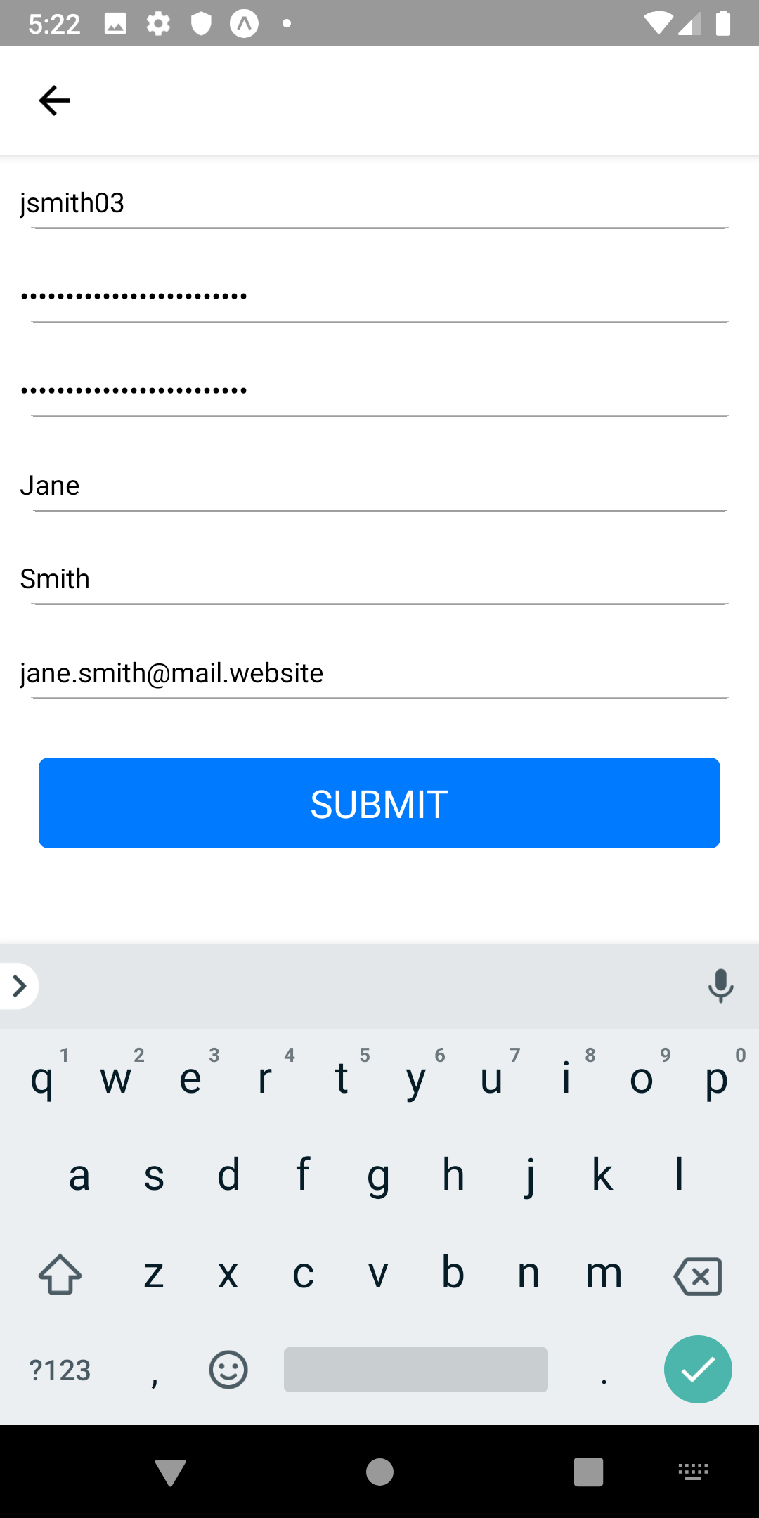
Save your progress
Create an account and learn across devices
Notes:
Highlight core features
Account system
Message history

Slide 4
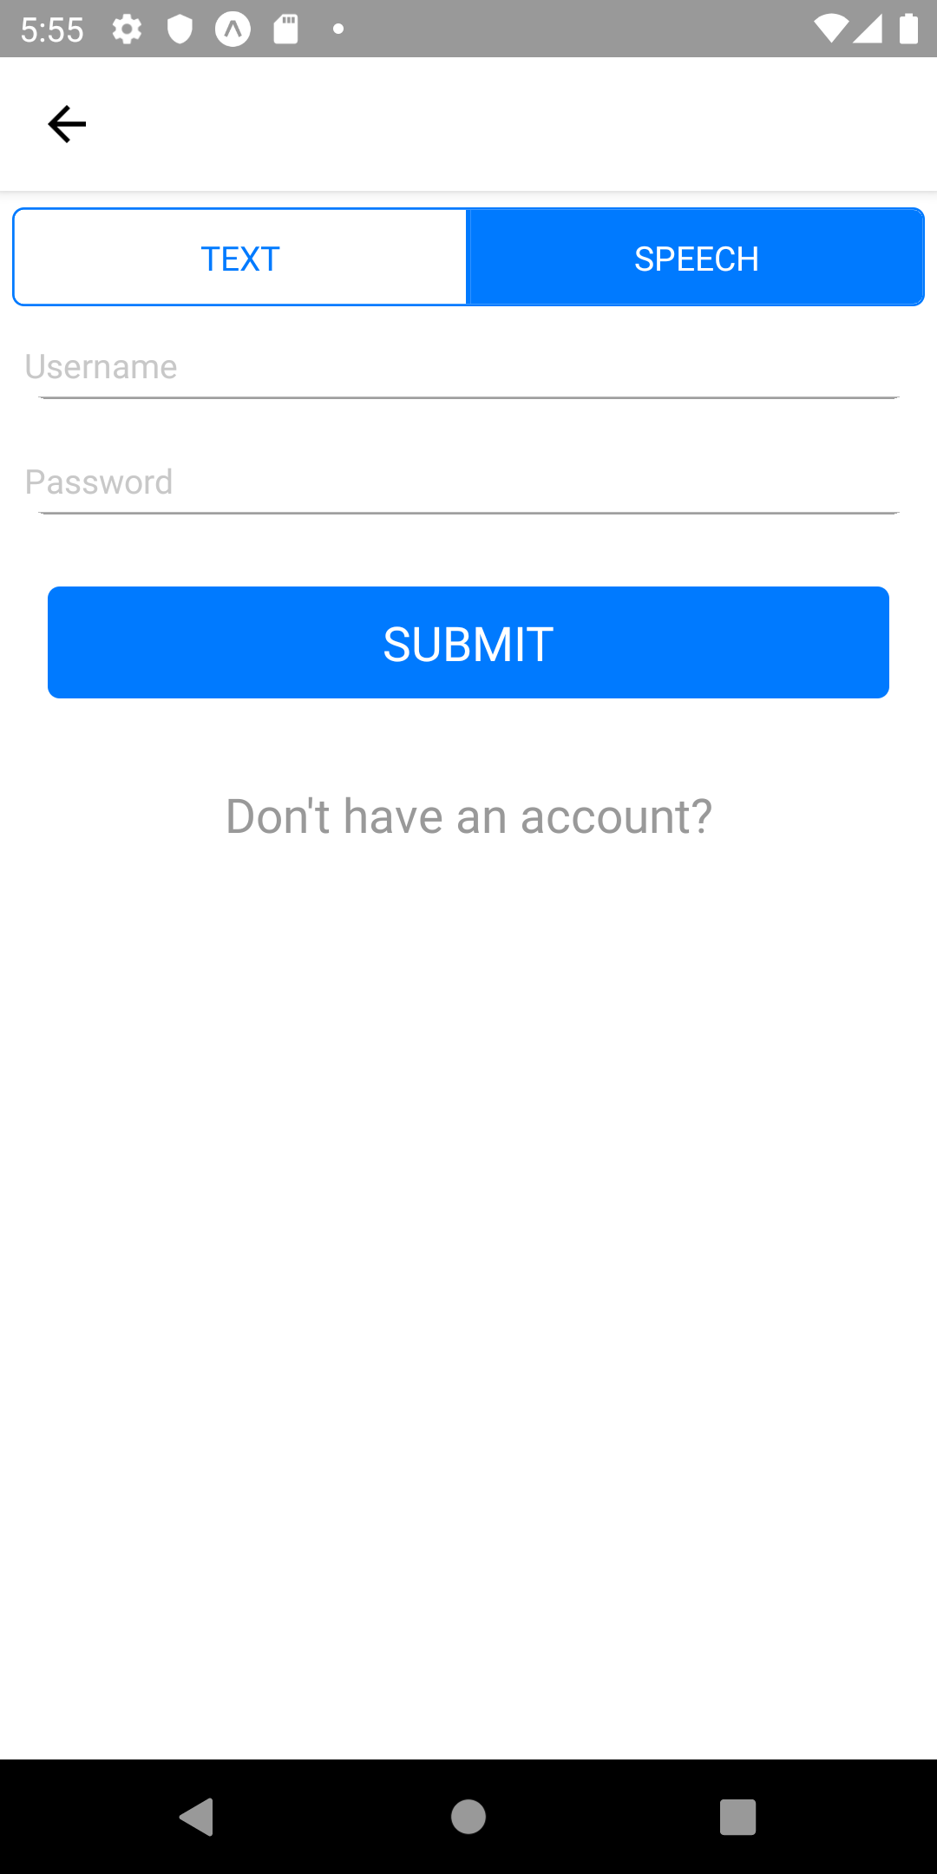
Have LangBot Speak to You
Learn how to speak Spanish as well

Slide 5
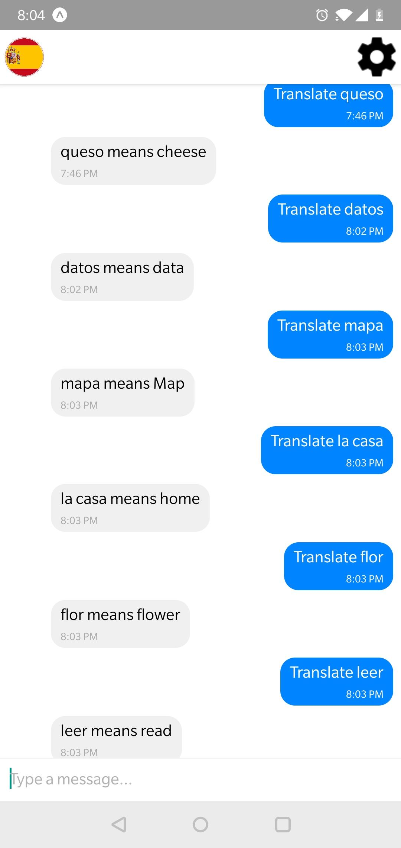
Translate Words and Phrases
Langbot has all the info you need

Slide 6
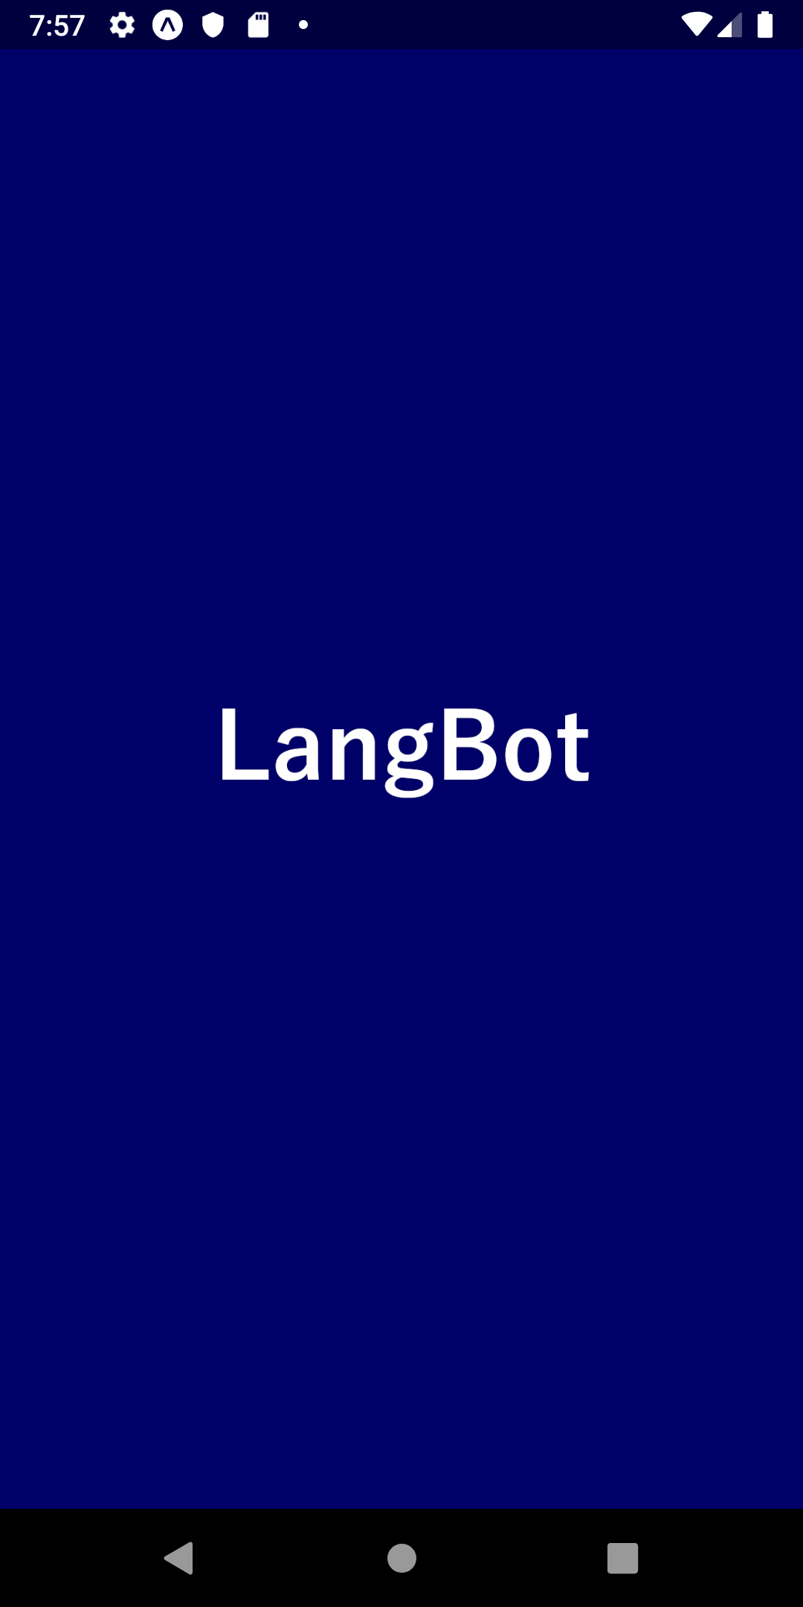
Demo Time!

Slide 7
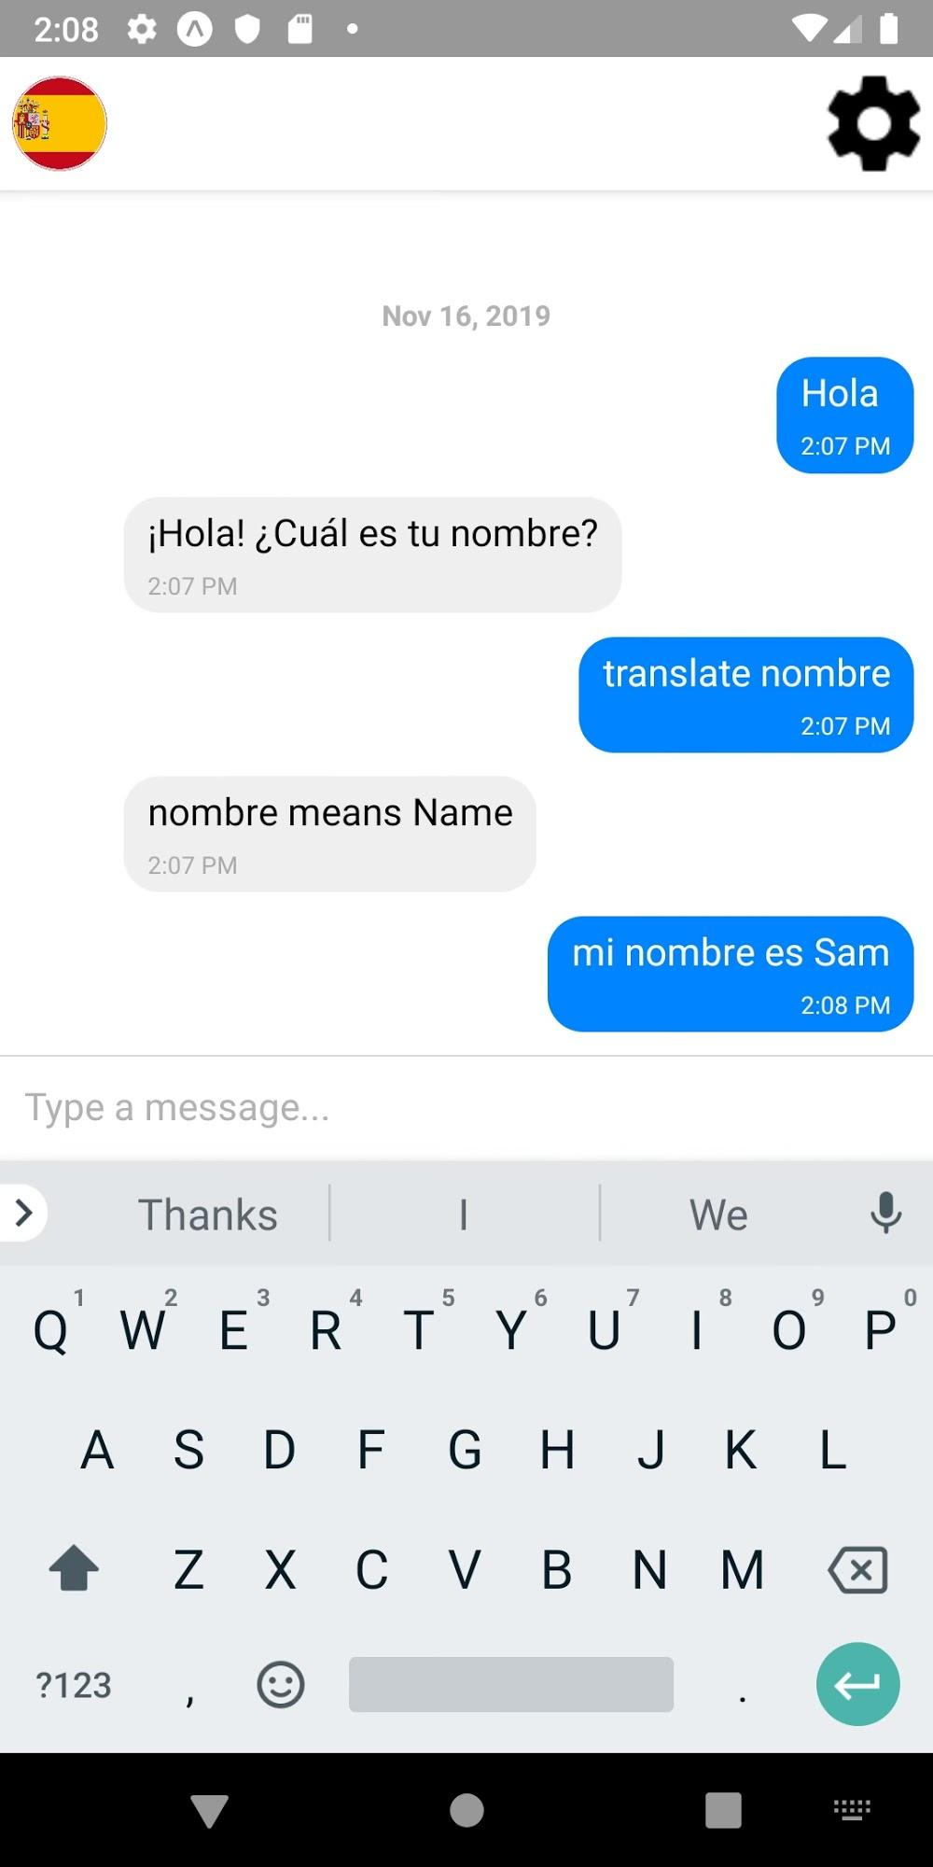
Notes:
User can practice holding a conversation in Spanish
When Langbot sends a response, it reads it out loud so the user can get used to hearing the language. This only happens when the user has enabled speech mode from the settings menu.
The bot currently handles beginner Spanish conversation topics, like hello/how are you/what’s your name, the weather, and activities.
From the main chat screen, you can access the settings screen and the language select screen, where the user can switch between languages in future versions of the app where multiple languages are supported

Slide 8
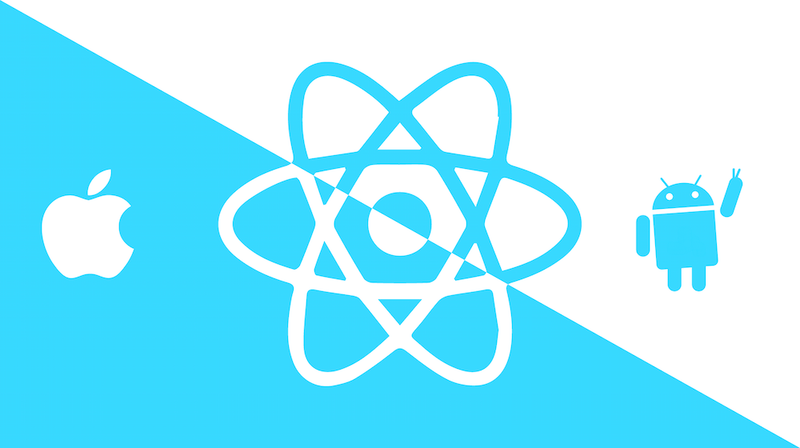

Tech Stack - Frontend
Notes:
[Liz] We made our app with React Native and Expo, which let us build cross-platform apps with only one codebase to maintain. They also provide some APIs that make it easy to work with native device functions that we need to use, like audio and storage.

Slide 9


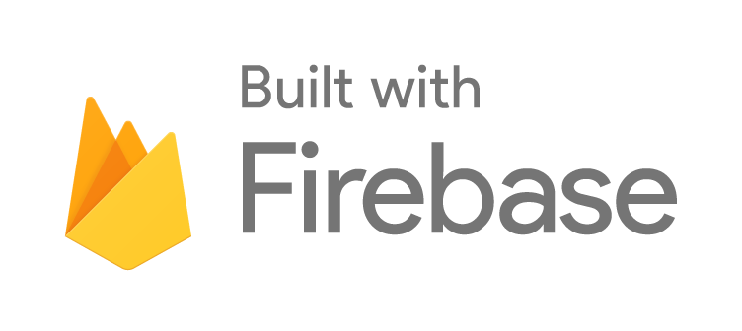
Tech Stack - Backend
Notes:
[Liz] On the backend, we used Google Firebase for messages and storing user account data. To process user input and manage the bot’s responses, we used Google Dialogflow. We also used the Google Cloud Platform’s Translation API for the translation feature.

Slide 10
Challenges
Libraries & Expo
Working with the simulator
Notes:
[Liz] This project definitely put our problem-solving skills to the test. One of the main issues we faced was that some of the Google-provided libraries for our backend didn’t work with Expo. We were able to get around this by finding different packages or making requests to the API directly. Through this, we got a better understanding of these Google services and were able to use them more effectively. Getting started was a challenge as well - it took us a while to figure out the best way to get Expo, the simulator, and our code all working together, but once we found a good workflow we were able to tackle the rest of the project. Taking the time to find a good development workflow helped us move along with the project much faster.

Slide 11

Interactive Learning
Learn what’s useful
Immersion
Business Value
Emphasis on practice over memorization
Real conversations, not textbook vocabulary
The best way to learn languages
Notes:
Business value
Instead of just throwing words at you and hoping that they stick, the user has an actual chance to practice the language in context and it won’t even feel like they are memorizing the language, but it will definitely have an impact on them
Some of the books used in regular classes are very outdated and contains terms that no one would realistically use, instead the user can engage in real conversations that would occur in everyday Mexico, France, or any place.
Time and time again immersion has been shown to be one of the quickest and most effective ways of learning a language and we would be making a huge mistake if we didn’t utilize it. A mix of seemingly simple phrases can lead the user into a fully immersed conversation.

Slide 12
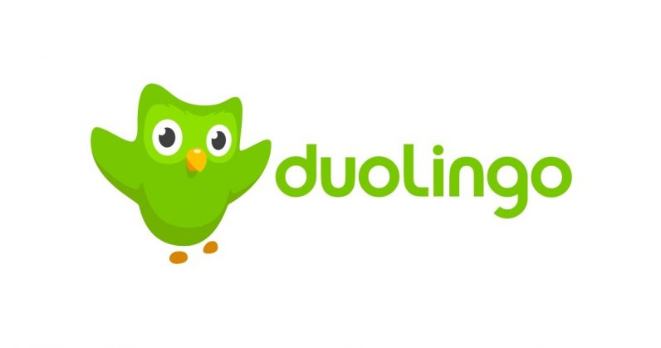

Competitors
Notes:
//Neither Rosetta Stone nor Dualingo provide an in-depth reason for mistakes/errors and thus it makes the experience feel less smooth
With LangBot, you don’t have to worry aboutinor issues like typos because it will interpret the errors and carry on like a normal conversation
Dualingo is interactive but lacks a “real-life” connection that LangBot provides
Rosetta Stone just resets when you make a mistake and doesn’t provide guidance
Neither
WITH LANGBOT, THE USER DOESNT HAVE TO WASTE TIME LEARNING HOW TO USE THE APP...INSTEAD THEY CAN JUST SPEND TIME LEARNING THE LANGUAGE

Slide 13
Future Plans
Multiple Characters & Themes
Multiple Languages
Integrate Machine Learning
Notes:
Over the past 11 weeks, our main focus was we getting the main functionality of the chatbot working with a simple conversation and an introductory theme. In the future, with the growth of our app, we would like to integrate machine learning so that we can train our own chatting model instead of manually entering thousands of dialogues and responses. This would also make it easier to implement multiple languages with multiple characters&themes.

Slide 14
Thanks!
Any Questions?

